Slide 1
Functions of Technology Management
Controlling

Slide 2
Chapter Overview
Steps in the Control Process
Three Types of Control
Characteristics of Effective Control Systems
Financial Controls
a. Financial Ratios used in Ratio Analysis
b. Financial and Operating Budgets
c. Nature of Budgeting Process
Non-Financial Controls

Slide 3
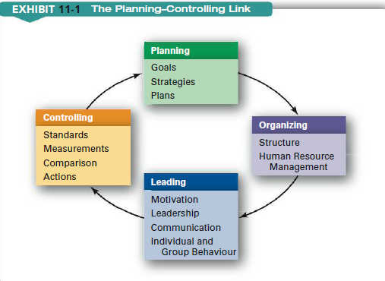

Slide 4
Controlling compelling events to conform to plans
Steps of Controlling
2. Measuring
Actual
Performance
Establishing
Standards
4. Corrective
Action
3. Comparing
Performance
with Standards
Planning
Controlling

Slide 5
Establishing Standards of Performance
Standards should be measurable, verifiable, and tangible.
a standard rate of production, a targeted value for product reliability, a desired room temperature, etc.
Benchmarking - the systematic process of measuring one’s performance against recognized leaders for the purpose of determining best practices that lead to superior performance when adapted and utilized.
Internal Benchmarking compares the results of one department, team or individual within an organization to another.
External Benchmarking compares statistical data with other organizations within the industry.

Slide 6
Measurement of the Actual Level of Performance
Data collection and analysis
Time study, work sampling, performance rating
Compare Performance with Standards
Establish limits of tolerance
Note variations (deviation within limits) and exceptions (deviation outside limits)
Provide recognition and warning

Slide 7
Corrective Actions
Short-term: Consultants, temporary workers
Long-term: Training, modifying procedures and policies

Slide 8
Closed Loop Vs. Open Loop Control
Closed-Loop: Automatic control which monitors and manages
a process by means of a self-regulating system // strong feedback
Open-Loop: Requires an external monitoring system
In Engineering Management, last step in control usually requires human judgment.
Example:
Machining process fails to maintain a specific tolerance
The machining problem (fixing)
Operator is not skilled enough (training)
Tolerance cannot be achieved for that material

Slide 9
Three Perspectives on the Timing of Control
Feedback Control: Example - thermostat.
Screening or concurrent control: Step-by-step control
Management By Walking Around (MBWA)
Feed forward (or preliminary or steering control): Predict the impact of current actions or events on future outcomes and adjust the current decisions to meet the future goals
Financial Statements

Slide 10
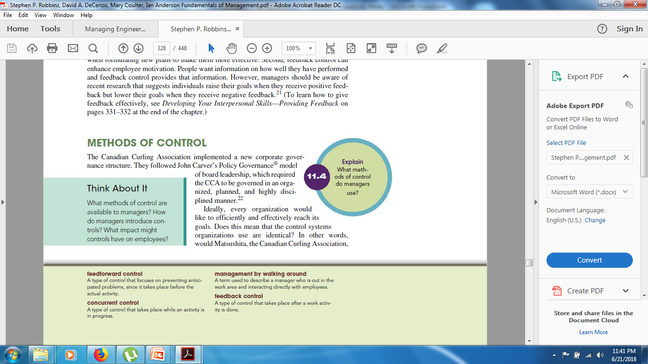

Slide 11
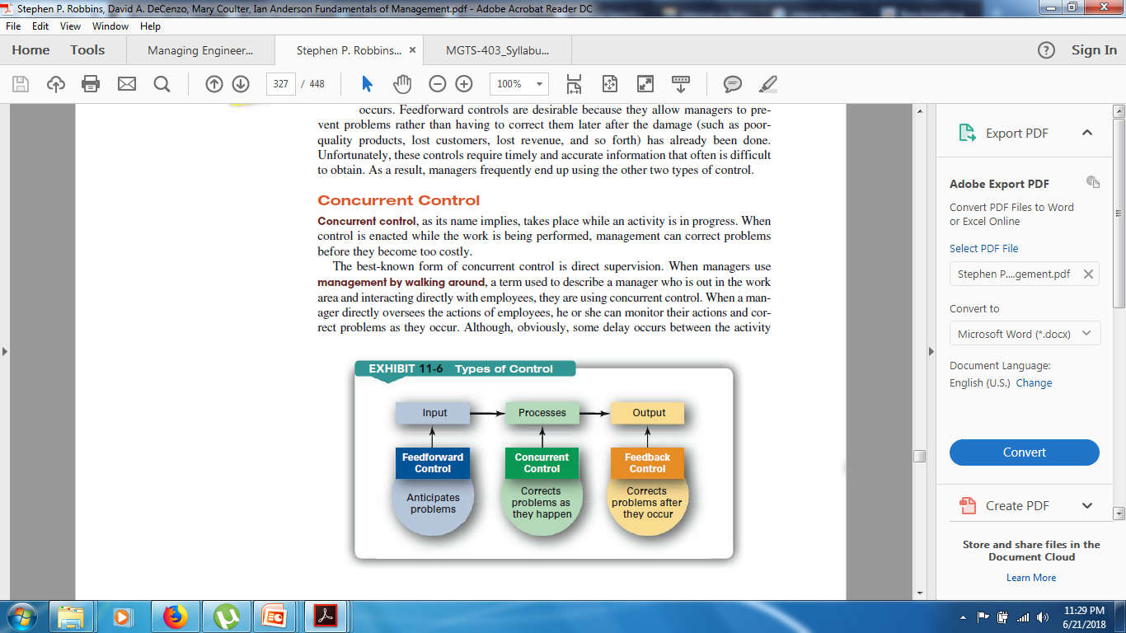

Slide 12
Characteristics of Effective Control Systems
Effective. Measure what needs to measured and controlled
Efficient. Economical and worth their cost
Timely. Enough time for corrective action
Flexible. Should be adjustable to changing conditions
Understandable. Should be easy to understand
Tailored. Deliver the information according to each level of manager
Highlight deviations. Flag parameters deviating from planned values
Lead to corrective action. Should incorporate means of corrective actions

Slide 13
Financial Controls
Financial Statements provide basic information for the control of cash and credit which are essential for company survival.
Three major types of financial statements:
Balance Sheet shows the company’s financial position at a particular instant in time
Income Statement shows the financial performance or operating results of the firm over a period of time.
Statement of Cash Flow shows where funds come from and what they are used for.

Slide 14
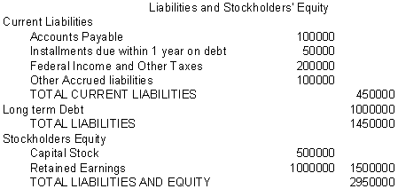
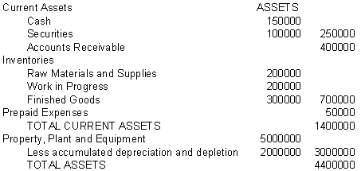
Sample Balance Sheet
What company owns
What company owes

Slide 15
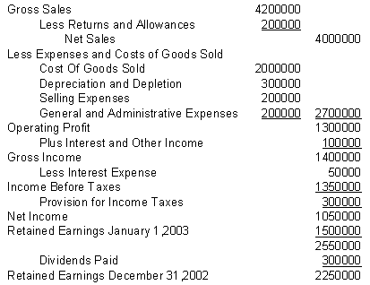
Sample Income Statement

Slide 16
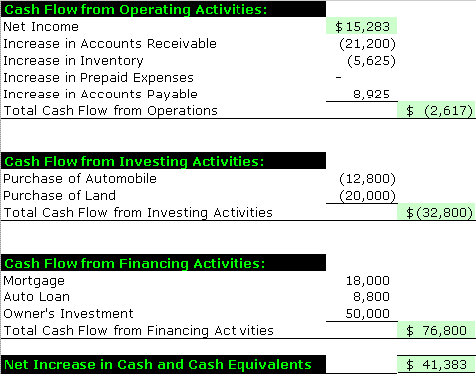
Sample Cash Flow Statement

Slide 17
Ratio Analysis
Financial ratios are ratios of two financial numbers taken from the balance sheet and/or the income statement.
compared with average values for the industry the firm is in to evaluate relative financial health, and
compared with earlier values from the same firm to evaluate trends.

Slide 18
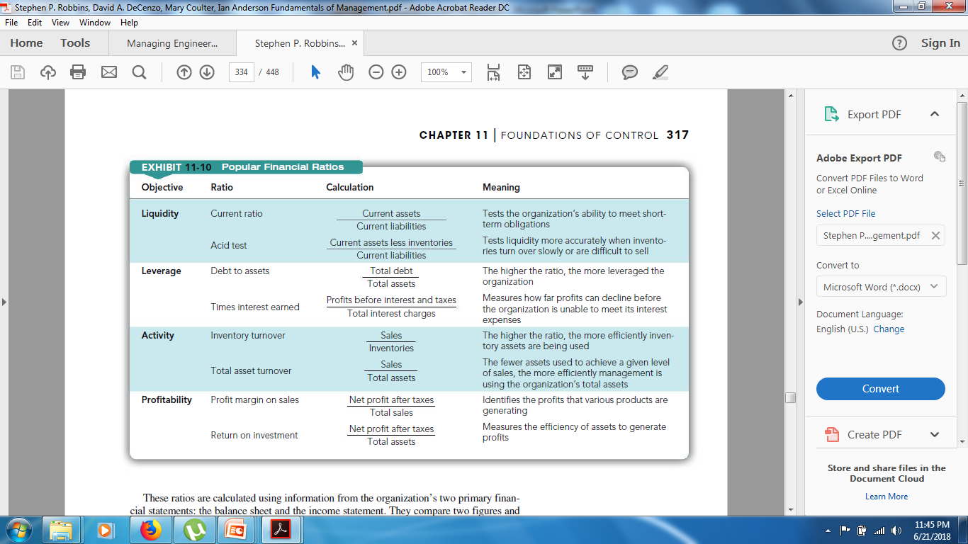

Slide 19


LIQUIDITY RATIOS: CURRENT RATIO
Current Ratio =
Current Assets
Current Liabilities
1400000
450000
= 3.11
Measure the ability
to meet short-term
obligations.
As minimum 2.0 is used
but it varies. A current
ratio of 10 shows
assets are not using
efficiently.

Slide 20
LIQUIDITY RATIOS: ACID TEST RATIO
Acid Test Ratio =
Current Assets-Inventory
Current Liabilities
1400000-700000
450000
= 1.56
For quickly converting
to cash we calculate
this ratio.
It is difficult to convert
inventories to cash,
Therefore, inventory is
extracted.
Over 1.0 is OK.

Slide 21
LEVERAGE RATIO: DEBT TO ASSET RATIO
Debt-to-Asset Ratio =
Total Debt
Total Assets
1450000
4400000
= 0.33
Relative importance of
stockholders and
outside creditors as a
source of enterprise’s
capital.
Rate is dependent on
the industry.

Slide 22
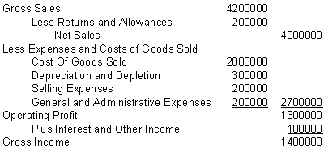
ACTIVITY RATIOS: INVENTORY TURNOVER
Inventory Turnover Ratio =
Cost of Goods Sold
Inventory
2000000
700000
= 2.86

Slide 23
ACTIVITY RATIOS: ACCOUNTS RECIEVABLE TURNOVER
Accounts Receivable Turnover Ratio =
Net Sales
Accounts Receivable
4000000
400000
= 10

Slide 24
ACTIVITY RATIOS: ASSET TURNOVER
Assets Turnover Ratio =
Net Sales
Total Assets
4000000
4400000
= 0.91

Slide 25
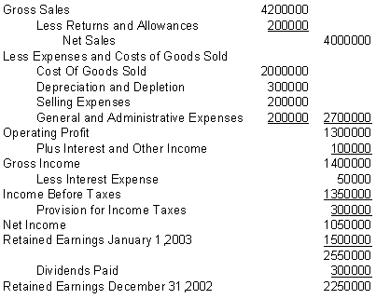
PROFITABILITY RATIOS: PROFIT MARGIN
Profit Margin Ratio =
Net Income
Net Sales
1050000
4000000
= 26.3%
Remember: Net Income should be Net Income After Tax or Net Operating Profit After Tax

Slide 26
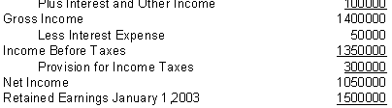
PROFITABILITY RATIOS: RETURN ON TOTAL ASSETS
Return on Total Asset =
Net Income
Total Assets
1050000
4400000
= 23.8%
Remember: Net Income should be Net Income After Tax or Net Operating Profit After Tax

Slide 27
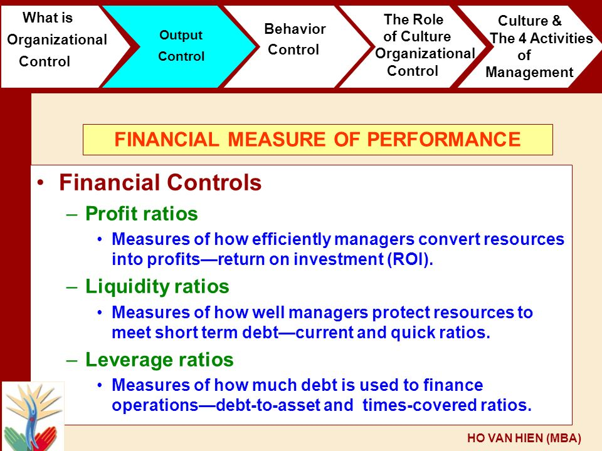

Slide 28
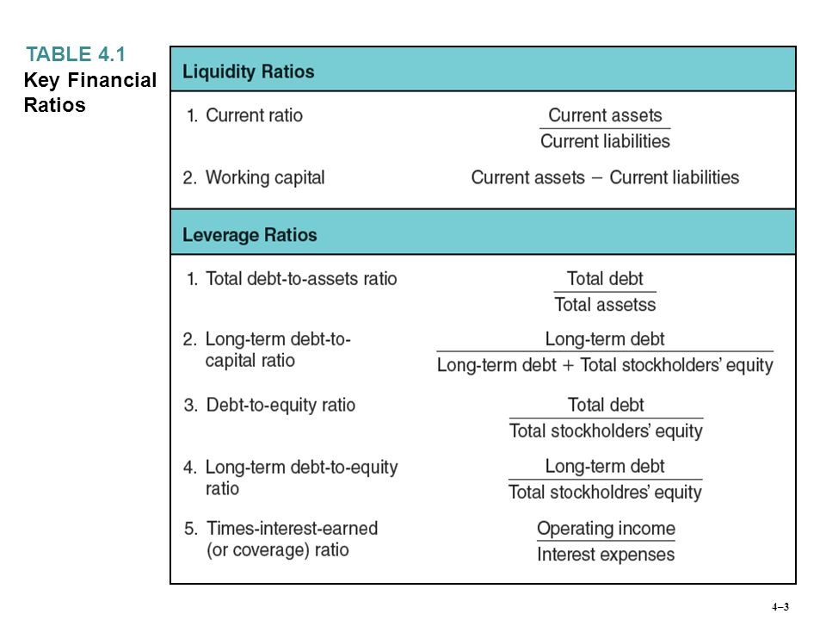

Slide 29
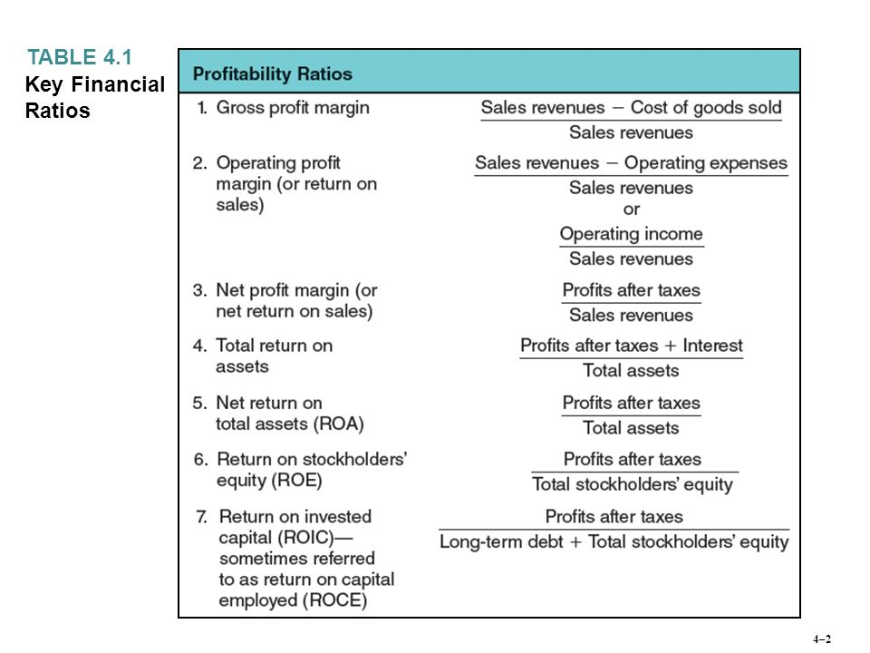

Slide 30
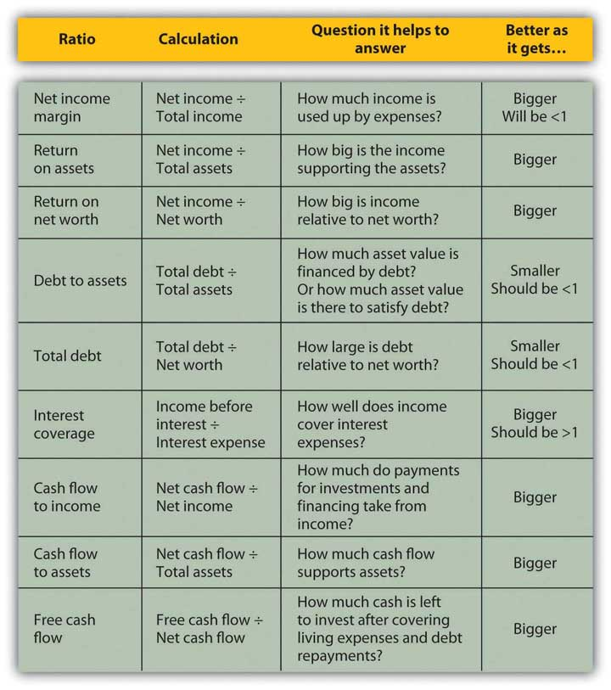

Slide 32
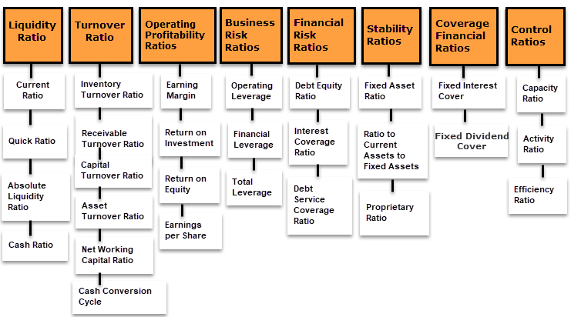

Slide 33
Budgets are plans for the future allocation and use of resources over a fixed period of time.
The budgeting process forces managers to think through future operations in quantitative terms and obtain approval of the planned scope of operations.
Financial budgets describe where the firm intends to get its cash for the coming period and hot it intends to use it.
Cash budgets estimate future revenues and expenditures and their timing during budgeting period.
Capital expenditure budgets describe future investments in plant and equipment.
Balance sheet budget uses the previous two estimates to predict what the balance sheet will look like at the end of the budgeting period.

Slide 34
For closer control, organizations are divided into responsibility centers
Expense or Cost Center: Primary financial concern is control of costs
Revenue Center (Sales or Marketing): The manager has revenue targets to meet
Profit Centers: For manipulating costs to increase profit.
Operating budgets can be created for each of these responsibility centers.
Expense budget
Revenue budget
Profit budget

Slide 35
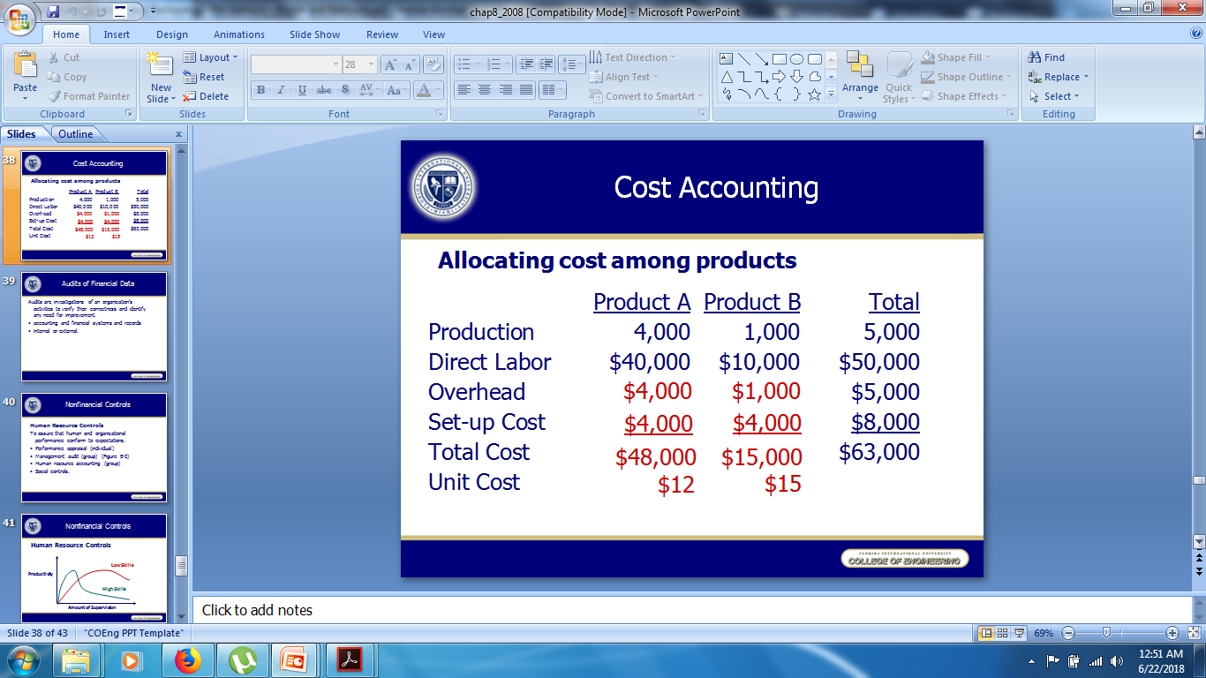
Cost Accounting
Allocating cost among products

Slide 36
Overheads
Costs that cannot be traced & attributed to the physical units of a product
A combination of all indirect costs which consists of indirect materials, indirect labour & indirect expenses

Slide 37
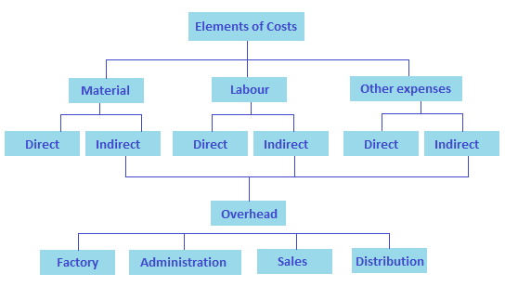

Slide 38
Audits
Audits are investigations of an organization’s activities to verify their correctness and identify any need for improvement.
External Audits: required at least once a year for publicly held organization by independent companies
Internal Auditing: carried out by company staffs in which auditing is performed in several subunits of the organization

Slide 39
Non-Financial Controls
Human Resource Controls
assuring that human and organizational performance conform to expectations.
Performance appraisal - management by Objective (MBO)
Tools to evaluate collective human and organizational performance
Management audit
Human resource audit
Social controls

Slide 40
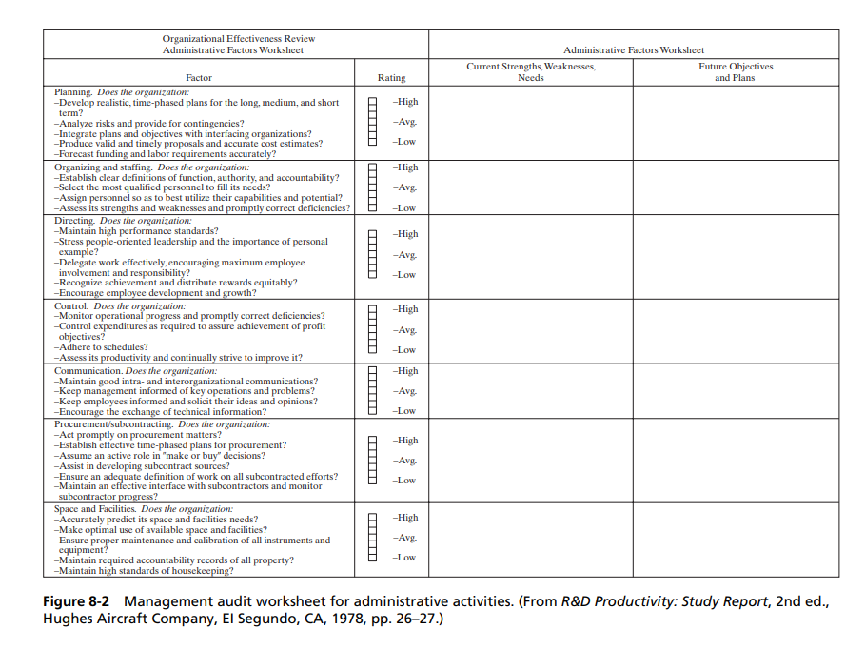

Slide 41
Human Resource Audit
Investments in acquiring outstanding people and in extensive training programs for them represent capital investments in the future as much as does the purchase of new machinery
Number of approaches to quantify the value of human resource investment
Social Controls
Building an organizational culture and controlling
Self-control

Slide 42
The excellent companies live their commitment to people, as they do their preference for action— any action—over countless standing committees and endless 500-page studies, their fetish about quality and service standards that others, using optimization techniques, would consider pipe dreams, and their insistence on regular initiative (practical autonomy) from tens of thousands, not just 200 designated $75,000-a-year thinkers. ...
The excellent companies seem to have developed cultures that have incorporated the values and practices of the great leaders and thus those shared values can be seen to survive for decades after the passing of the original guru. Second, .. .it appears that the real role of the chief executive is to manage the values of the organization

Slide 43
The excellent companies
Live their commitment to people,
Fetish about quality and service standards that others,
Uses optimization techniques
Consider pipe dreams
Develop cultures that have incorporated the values and practices of the great leaders and thus those shared values can be seen to survive for decades after the passing of the original guru.
Second, .. .it appears that the real role of the chief executive is to manage the values of the organization

Slide 44
For values imbued in the corporate culture to be effective requires that employees in general exercise self-control over their actions. Like other control systems, self-control requires:
• The existence of standards (knowledge by the general worker of the organization’s objectives and values)
• Comparison with actual outcomes (which implies feedback of performance to the individual, not just to management or a “quality control” group)
• Corrective action (which requires that the individual have the tools, the autonomy, and the motivation to make corrections)

Slide 45
Other Nonfinancial Controls
Methods of evaluating the effectiveness of research activities
Control systems for drawing release and for engineering design changes (configuration management)
Effective production management
Inventory control
Quality control
Project management – schedule, cost, and the performance of resulting product.

